Slide 1
Wind Turbines in the US
File created on: 1/27/2022 3:57:55 PM

Slide 2
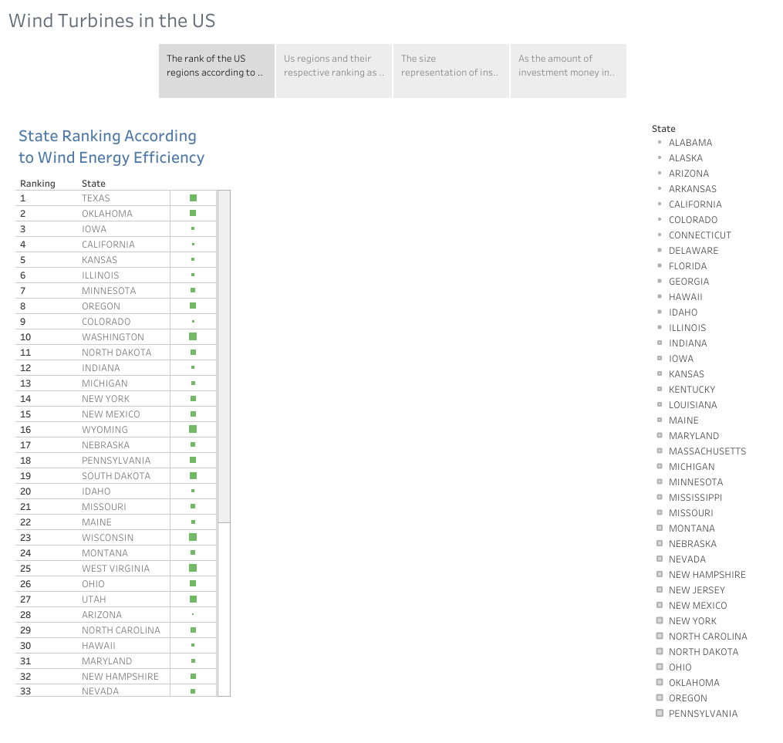

Slide 3
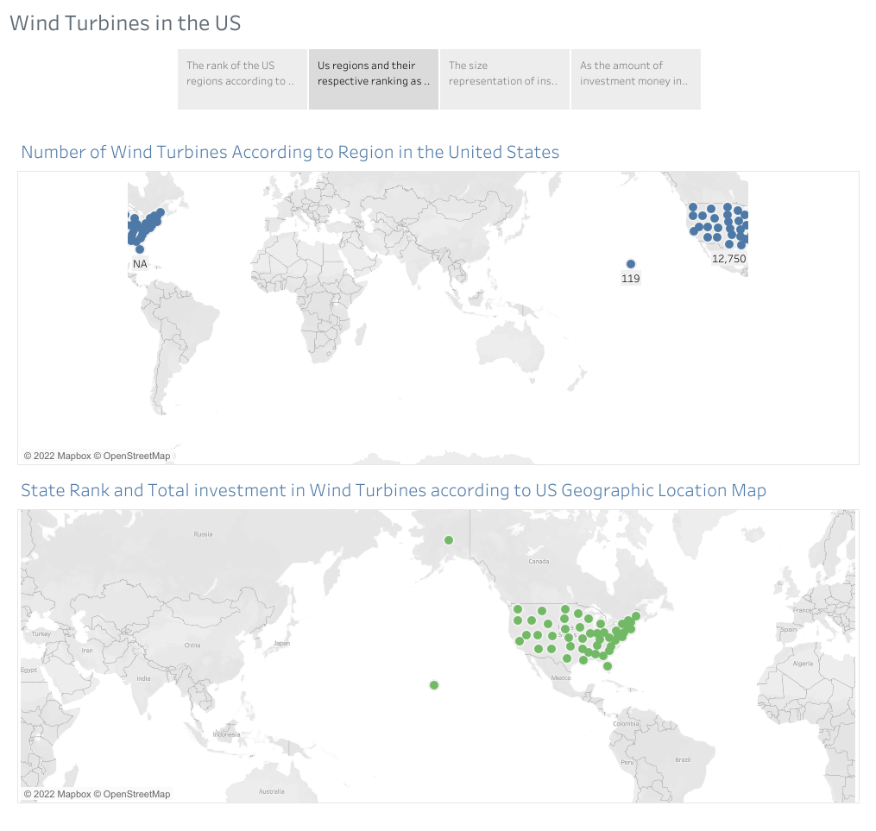

Slide 4
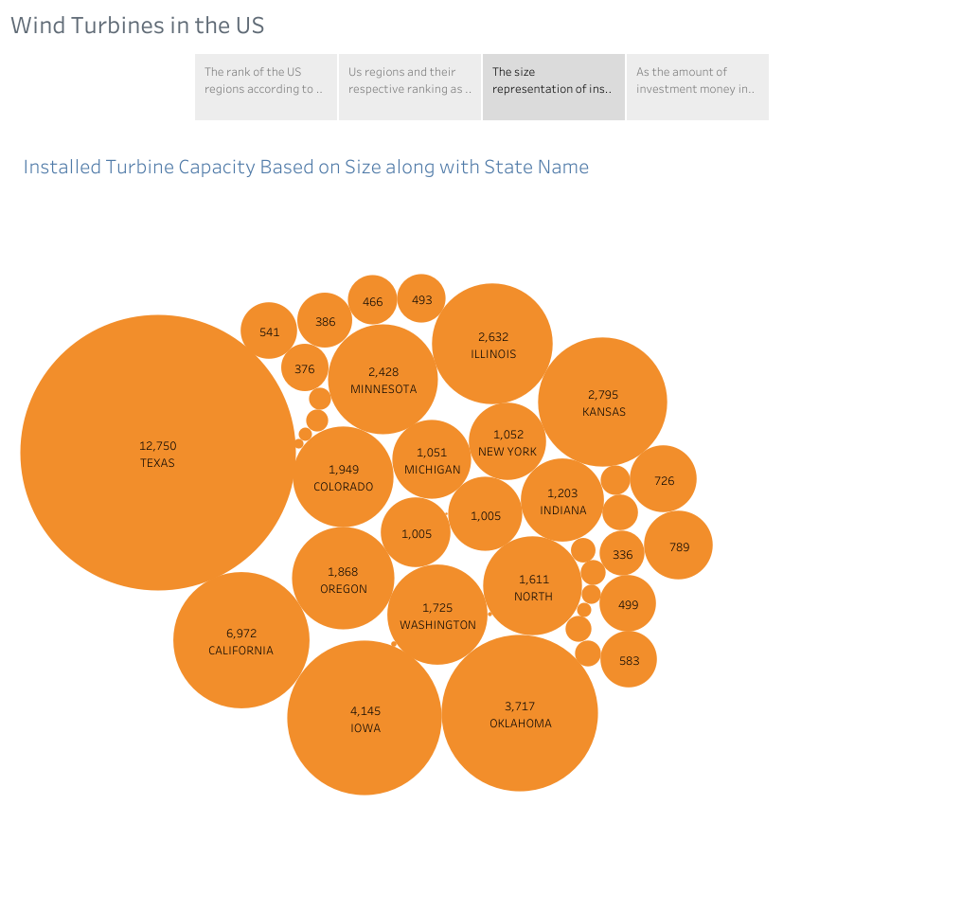

Slide 5
